Slide 1
Keeping Children Safe Online

Slide 2
Online Risks
Cyber bullying / peer to peer abuse
Harmful content / illegal materials - age limits on games, other age related material
Privacy / digital footprints
Unwanted contact / grooming

Slide 3
Cyber Bullying
Invasion of personal space. Home is no longer a safe space.
It is easy to masquerade as someone else online.
People are removed from their words and more likely to say aggressive and hurtful things.
Anyone can be a target of cyber bullying.
Be aware that your child could be the cyber bully.

Slide 4
Cyber Bullying
Keep records of the contacts.
Be careful not to over react – your child may not report another incident to you.
Be careful not to under react and dismissive.
Make them feel safe and supported.
Speak to the school.
Use the ‘report abuse’ button.
Speak to the police.

Slide 5
Harmful Content
Exposure to content which is not age appropriate
This can be both intentional and non intentional
Access to illegal material
Recent case of girl committing suicide after viewing disturbing material on Instagram.
Slenderman linked to acts of violence.
Consider where the computer is located or where/when they use mobile devices

Slide 6
Harmful Content
Parental controls can be set through the browser, ISP or specific web filters.
The easiest way of introducing controls is through your web browser.
Chrome – supervised chrome profile
Internet Explorer – enable Content Advisor
Details of how can be found on our website
Click on ‘Parents’ and ‘E-safety’.

Slide 7
Privacy and Digital Footprint
Everything online leaves a footprint
Once information is online it is very difficult to remove as it can be copied
Long term effects – job or university applications
There can be a negative impact of something ‘going viral’
They can easily be traced - location settings and checking in on Facebook

Slide 8
Online Grooming
"actions deliberately undertaken with the aim of befriending and establishing an emotional connection with a child, in order to lower the child's inhibitions in preparation for sexual activity with the child"

Slide 9
https://youtu.be/WsbYHI-rZOE

Slide 10
Online Grooming Techniques
Bribery and gifts
Flattery
Sexualised games
Threats
Blackmail
Desensitisation - pornography, child abuse images, video and web cams may be used

Slide 11
Problem Areas
Mobile Technology
Instant Messages & Private Chat
Online Gaming
Social Media
Live Streaming

Slide 12
Mobile Technology
Unwanted contact – devices are always at hand
Images are easily taken and uploaded
Location based services
Don't enable location or geo tagging (Snap Map)
Only let friends you know in the real world know your phone number
Think before you post
Understand the safety functions and how to report abuse
Do they need the internet on their phone?

Slide 13
Instant Messaging and Private Chat
Never accept people you do not know and trust
Do not give out personal information
Remember that webcams can be hacked
Do not webcam with people you do not know
Turn the webcam off or cover it up
Delete people that make you feel uncomfortable
Know how to report a problem

Slide 14
Online Gaming
Games consoles have Internet access
Games are played with headsets. Language can be very inappropriate.
There are games where funds are needed. Some children using parents' card details. Often card details are stored on the account.
People can use game credits as bribes.

Slide 16
Fortnite
The game IS free but there are in game purchases – battle passes and skins. X-Box requires Gold Subscription.
It can be addictive
It can be played on the go (IOS and Android). Do you know how much they play?
Accounts can be hacked and credit card details used.

Slide 17
Fortnite
Talking to strangers – headphones often used. A man has recently been arrested for grooming using Fortnite.
No proof of age required – PEGI 12 (‘Frequent scenes of mild violence)
Social media scams – accounts of social media promising ‘V Bucks’ (in game currency) when information such as username and password is submitted.

Slide 18
Fortnite - Tips
Limit game time – possible to limit on PC and Xbox but harder on mobile devices. Hard to stop mid match, maybe limit matches instead (about 20 mins each)
Restrict payment methods – Is your card associated with the account? Could you instead use a games console gift card?

Slide 19
Fortnite - Tips
Show them how to report – use the in game feedback tool located in the main menu.
Prevent them from talking to strangers – open the settings menu in the top right of the main page, then click on the cog icon. Open the audio tab at the top and from there you can turn off voice chat.

Slide 20
Fortnite - Tips
Look out for Vbuck scams – have conversations and make them aware. Remind about personal information and password security.
Use a strong password

Slide 21
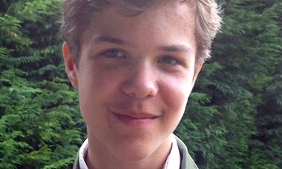
Online Gaming
Breck Bednar, 14, from Thurrock

Slide 22
Age Restrictions for Games
PEGI - the pan European game age rating system
Many games contain violence, sexual content, drugs, bad language
Would you let them watch an 18 film?
It is an offence to buy these games for children although prosecutions are rare.

Slide 23
Social Media Statistics
One in four 8 to 11 year olds has a social media profile. Three in four 12 – 15 year olds do.
1 in 4 children have experienced something upsetting on a social networking site.
1 in 3 children have been a victim of cyber bullying.

Slide 24
Social Media Statistics
About 28 per cent have had a stranger contact them through an online channel.
Of the 11 – 12 year olds that have been contacted, 18 per cent do not tell their parents or guardians and 11 per cent actually chat with the person.

Slide 25
Social Media Statistics
Around 1 in 7 young people have taken a semi-naked/naked picture of themselves. Over half went on to share the picture with someone else.
Every year Childline holds thousands of counselling sessions with children about sexual abuse online.

Slide 26
https://youtu.be/599I1E-rWTU

Slide 27
Tips for Young People
Cinema screen test - would you be happy to put that image on it? If not, don't post it online.
Use strong passwords.
Facebook settings – friends only. Are they really your friends?
Only post comments and photos that you would be happy for everyone to see.
Learn how to report any issues.

Slide 28
Tips for Young People
Try not to buy into the idea that the more ‘likes’ you have, the more worthy or popular you are (and vice versa).
Be critical of what others post. Their lives are often not what they show on social media.

Slide 29
Social Media – Self Esteem
People determine their worth with ‘likes’.
Staged photos create unobtainable comparisons.
Being ‘left on read’ leaves a sense of rejection.

Slide 31
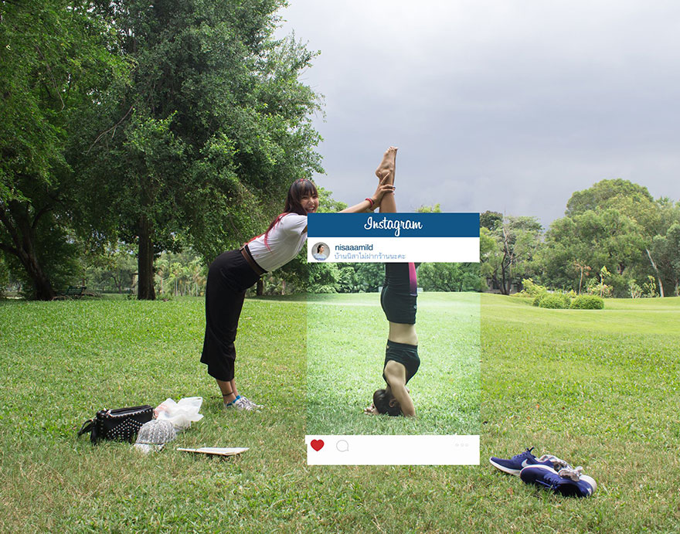

Slide 32
Social Media Tips for Parents
View your child’s profile;
be ‘friends’ with them;
check through the privacy settings and change to ‘friends only’;
keep abreast of changes;
'like' the Ceop page to receive updates.
Have conversations about how they feel about ‘likes’ on their posts. How many ‘likes’ would they consider good/bad?
Discuss what is going on ‘outside of the frame’.

Slide 33
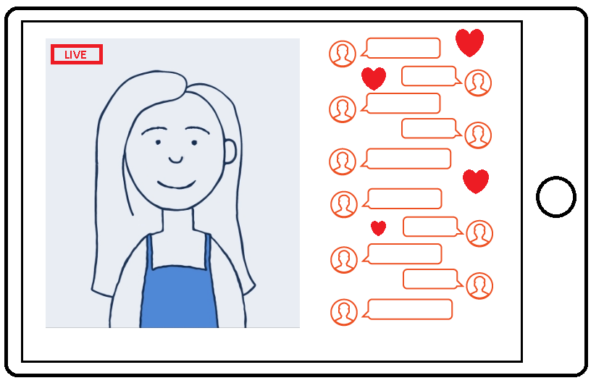
Live Streaming
Live stream
Unpredictable and difficult to moderate.
Although live, they can be permanent.
Children can be manipulated through comments section.
Tags
Emoji’s/Gifts
#dancing
Live comments

Slide 34
Key messages
Think about how many online access points your children have.
Can they use the internet without supervision?
Would you know if they were in contact with someone to whom they should not be talking?
Talk to your child about their internet use.
Do not be afraid to report concerns to the school, CEOP or the police.
Please ask for advice or help with anything.

